Slide 1


Introduction to Python & AI
A Beginner’s Journey into Programming and Intelligent Systems

Slide 2

Overview
What is Python
Installation Guidelines
Basic Concepts
Live examples
https://denizhalil.com/wp-content/uploads/2024/02/Cybersecurity-with-Python-A-Comprehensive-Roadmap-by-denizhalil.jpeg

Slide 3
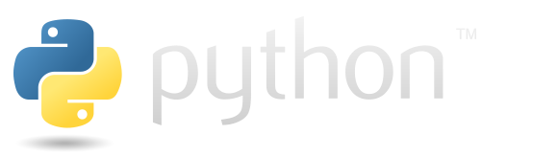
What is Python
Python is a high-level, general-purpose programming language used in web development, data science, machine learning, automation, and more. Python is known for its readability, ease of learning, and the vast number of libraries and frameworks available for various tasks.

Slide 4
What is Python?
High-level, general-purpose language
Easy to learn and read
Used in many fields

Slide 5
Installing Python
Download from python.org
Run the installer for your OS

Slide 6
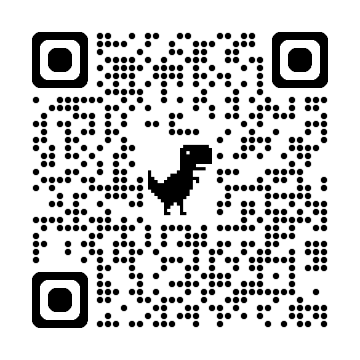
Installation Guidelines
To install Python, first download the appropriate installer from the official Python website. Then, run the installer and follow the on-screen instructions. During installation, consider adding Python to your system's PATH to easily access it from the command line. Finally, verify the installation by opening a command prompt and typing python -V

Slide 7
Python Shell vs. Scripting
Shell: interactive
Script: saved .py files

Slide 8
Example

Slide 9
Python IDEs
IDLE, VS Code, PyCharm, Jupyter

Slide 10
Data Types and Variables
int, float, str, bool
Dynamic typing

Slide 11
Type Conversion
int(), float(), str(), bool()

Slide 12
Variables and Assignment
Variables store data
Use '=' for assignment

Slide 13
Basic Operators
Arithmetic, Comparison, Logical

Slide 14
Control Structures
if, elif, else
for, while
break, continue, pass

Slide 15
Example

Slide 16
Basic Data Structures
Lists, Tuples, Sets, Dicts

Slide 17
Functions
Define with def
Use return
Scopes: local/global

Slide 18
Modules and Packages
import statements
Third-party and standard

Slide 19
Exploring the Standard Library
Includes os, sys, datetime, etc.

Slide 20
Break

Slide 21
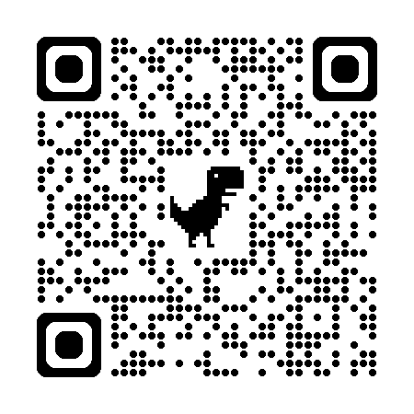
Challenge
https://lotaylor23.github.io/MS-CC_2025/index.html

Slide 22
End of Day 1

Slide 23
What is AI?
Simulates human thinking
Learns from data

Slide 24
AI vs. Traditional Programming
Traditional: rules
AI: learns patterns

Slide 25
AI vs. Automation
Automation: fixed rules
AI: adaptive

Slide 26
Steps for Building AI
1. Define the problem
2. Collect data
3. Choose tools
4. Select algorithm
5. Train model
6. Evaluate results

Slide 27
Example

Slide 28
Discussion

Slide 29
End of Day 2

